Slide 1
Multi-layer Router
A* routing algorithm
Rinal Mohamed Andrew Fahmy

Slide 2
Technical Background
The project is an implementation of a routing technique that routes the nets following A* algorithm after the placement step
This implementation supports multi-layer routing, so we can use metal1 layer, metal2 layer, and up to metal 6 layer.
The project implements the Manhattan movement to motion itself on the grid

Slide 3
Main components of the project
The project is contained in 2 main components
The main code that includes the implementation of the main functions that are used to route the net
A script that takes a file representing the obstacles in the layer and prints the routed nets

Slide 4
Main functions and the flow of the code
The code starts by reading from a file that has all the nets that need to be routed.
The cells of the grid are described through the cell struct and this struct contains the position of the cell in the grid, whether they’re visited or not, whether they are obstacles or not , the number of the cell in the routed path(the delay to a given cell), and whether it is a source or destination cell.
There is then a loop that loops over the nets in the input file and process them one by one.
Each net that is read from the input file goes through the main steps of the algorithm to allocate it as either a source or a destination.

Slide 5
Main functions and the flow of the code (continued)
The destinations of a cell are pushed to destinations vector and the source is passed to the BFS function to find a path from the source to the destination
The source is given BFS number 1 and is on the top of the queue
Multiple targets are handled through a loop that checks all the targets for a net after they are pushed in the destination vector and connect them afterwards one by one.
The parser function is a utility function that reads the position of the pins in the net.

Slide 6
Main functions and the flow of the code (continued)
Calculate is the major function in the project as it gets called all the times by the BFS function to search for the shortest path implementing the Best-first search.
Calculate function also includes the main heuristic of the back-tracking implemented in the project since it pushes each next path into the BFS queue till it reaches the final destination
Also, Calculate function considers and alerts about paths that are stuck and cannot be implemented due to obstacles.

Slide 7
Main functions and the flow of the code (continued)
The delay from start to end is given and the size of the bfsQueue.
The final path is then printed into an output file from source to destination and the next net starts its implementation.

Slide 8
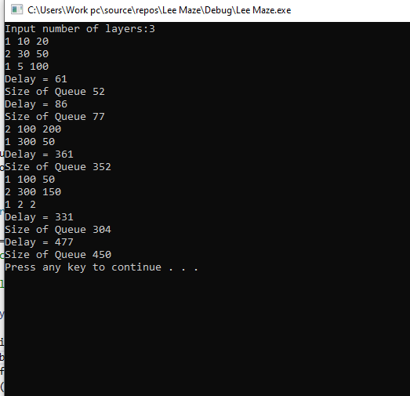
Test case 1
net1(1, 10, 20) (2, 30, 50) (1, 5, 100)
net2(2, 100, 200) (1, 300, 50)
net3(1, 100, 50) (2, 300, 150) (1, 2, 2)

Slide 9
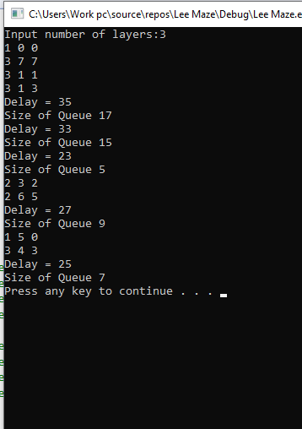
Test case 2
net1(1, 0, 0) (3, 7, 7) (3, 1, 1) (3, 1, 3)
net2(2, 3, 2) (2, 6, 5)
net3(1, 5, 0) (3, 4, 3)

Slide 10
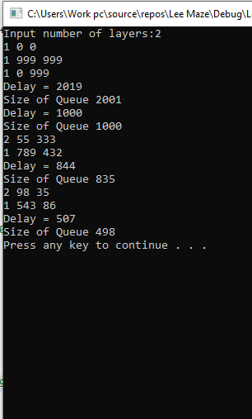
Test case 3
net1(1, 0, 0) (1, 999, 999) (1, 0, 999)
net2(2, 55, 333) (1, 789, 432)
net3(2, 98, 35) (1, 543,86)

Slide 11
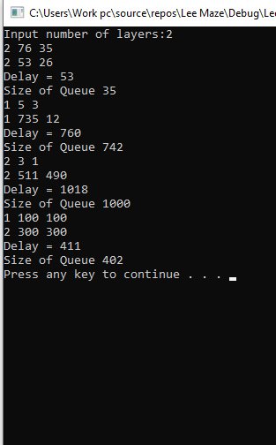
Test case 4
net1(2, 76, 35) (2, 53, 26)
net2(1, 5, 3) (1, 735, 12)
net3(2, 3, 1) (2, 511, 490)
net4(1, 100, 100)(2, 300, 300)

Slide 12
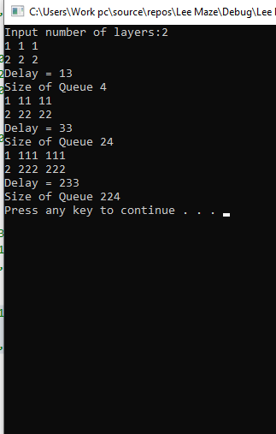
Test case 5
net1 (1, 1, 1) (2, 2, 2)
net2 (1, 11, 11) (2, 22, 22)
net3 (1, 111, 111) (2, 222, 222)

Slide 13
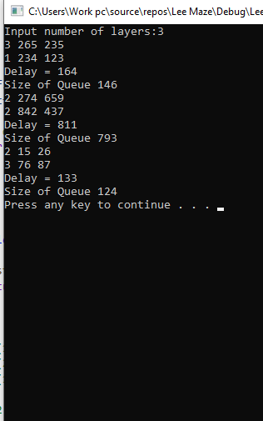
Test case 6
net1(3, 265, 235) (1, 234, 123)
net2(2, 274, 659) (2, 842, 437)
net3(2, 15, 26) (3, 76, 87)

Slide 14
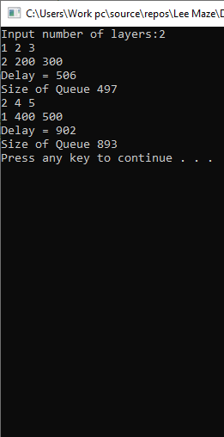
Test case 7
net1(1, 2, 3) (2, 200, 300)
net2(2, 4, 5) (1, 400, 500)

Slide 15
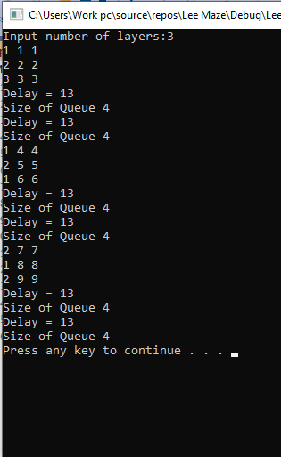
Test case 8
net1 (1, 1, 1) (2, 2, 2) (3, 3, 3)
net2 (1, 4, 4) (2, 5, 5) (1, 6, 6)
net3 (2, 7, 7) (1, 8, 8) (2, 9, 9)

